Slide 1

Prerequisites for Winning the League
SRM INSTITUTE OF SCIENCE AND TECHNOLOGY
FACULTY OF ENGINEERING AND TECHNOLOGY
DEPARTMENT OF COMPUTER SCIENCE AND ENGINEERING
CS2050 PROJECT PHASE II
Student Reg No: RA1711003010280
RA1711003010296
Guide name and Designation:
Dr. Kalaiselvi (Assistant Professor)

Slide 2
TABLE OF CONTENTS
Abstract
Introduction
Literature survey
Inference from the Survey
Objective of the Research Work
Scope
Architecture Diagram
Implementation
Result and Discussion
References

Slide 3
ABSTRACT
Over the past decade, Data Analytics has been increasingly utilized for the purpose of predicting how a team sets itself up, how it scores goals and how it concedes goals.
Many football clubs use such techniques to improve their game and play better against opposition. Our research highlights how football has changed over the years i.e. which type of playing style has bestowed success upon teams.
The research would exhibit many trends such as in passing accuracy, defensive tackles, etc. which will be demonstrated using regression analysis,time-series analysis, statistical analysis. Finally, our study uncovers common themes required for the football club to win the league.

Slide 4
INTRODUCTION
Football. The most popular sport in the world.A concentrate of passion, hope and romanticism.
Every year thousands and thousands of teams compete in their leagues with different purposes.
Some of them are built to win the title.Others just don’t want relegation.
But the answer to their hopes always relies on the same thing:Numbers.
One point more and you succeed. One point less and it’s a failure.
One goal more and you are the champion.
One goal less and you throw away the all season.

Slide 5
LITERATURE SURVEY
Year : 2014
Author : Krzysztof Durlik , Paweł Bieniek
Title : Analysis of goals and assists diversity in English Premier League
Advantages:
Goals scoring pattern in both halves .
How many goals were scored in a certain period of the 90 mins. .
Drawbacks:
Only 1 season (2008/09) season of the PL was analysed

Slide 6
LITERATURE SURVEY
Year : 2020
Author : Alliance Kubayi
Title : Analysis of Goal Scoring Patterns in the 2018 FIFA World Cup
Advantages:
Short ball possession yielded a higher number of goals.
VAR ( video assistant referee) was used which resulted in more penalties.
Drawbacks:
Only 1 tournament was analysed.
PPDA , xG, xA were not taken into account.

Slide 7
INFERENCE FROM SURVEY
The number of datasets used was very low.
Only a few analysis techniques were used.
The information on tactics were not mentioned and used as they play a big role while analyzing football matches.
The analysis on xG and xPoints were not taken into consideration.
Pressing (PPDA ) was not taken into consideration

Slide 8
OBJECTIVE
Is there a pattern in which goals were scored?
What trends have there been in club football - home advantage, total goals scored, distribution of teams' strength
How much did home advantage come into play? Dissecting every teams win and loss ratio at home and away to get a sense of where they are comfortable
How has a player’s role changed through decades as CB(Centre Back), Goalkeeper with the evolution of new styles of play , how much more are they involved in the build up play, coming out of the box,etc.
How much did players press during a season?
What is actually needed for Football Clubs to win the league ?

Slide 9
PURPOSE AND SCOPE OF PROJECT
PURPOSE
To determine what offensive and defensive measures are needed from football players and the team as a whole to win the league.
To analyse what kind of form the teams have to show to better the opponent and what requirement is needed to go on a winning run.
SCOPE
To accumulate all the data and find out patterns in numbers of winning teams which can help in discovering the needful to be implemented by the team to win the league.

Slide 10
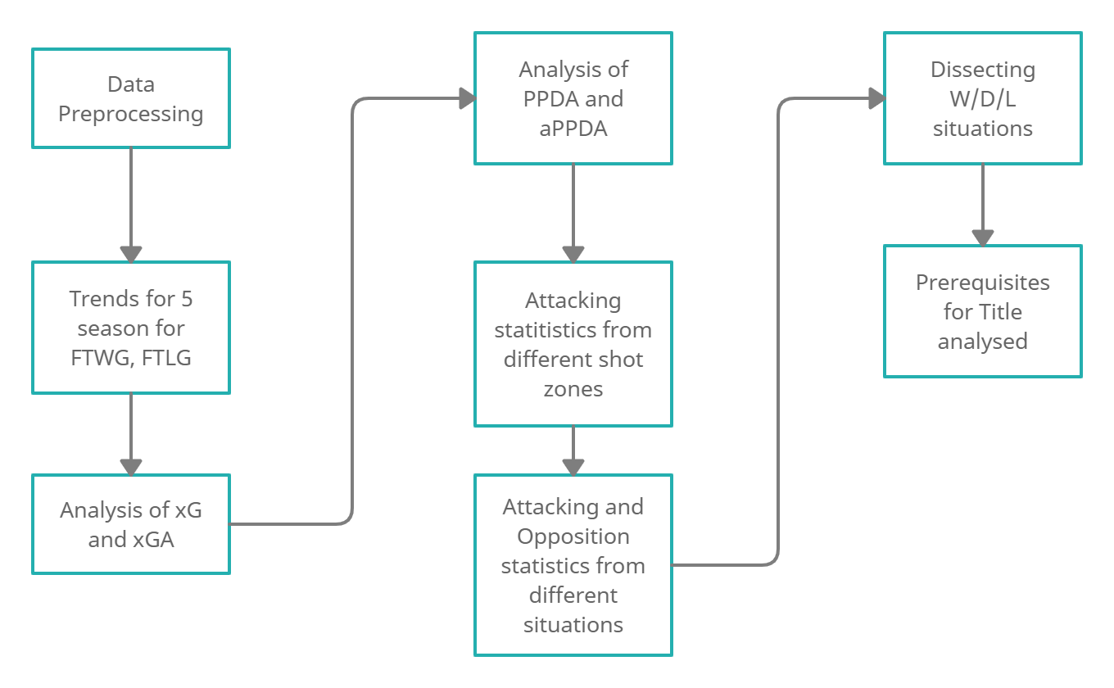
ARCHITECTURE DIAGRAM

Slide 11
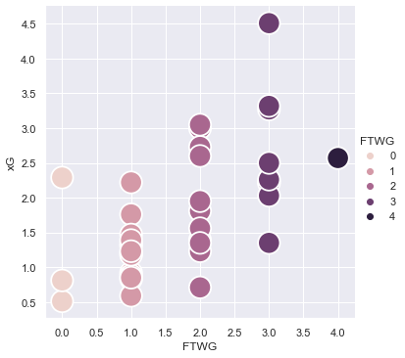
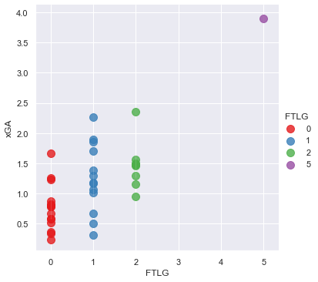
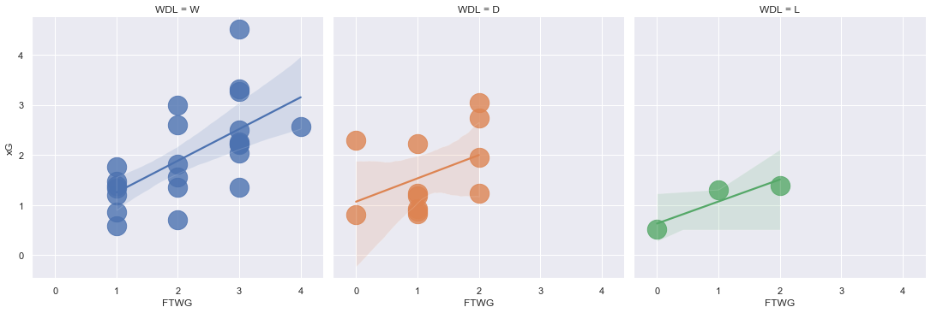
IMPLEMENTATION 15/16
Notes:
Leicester City 2015/2016
Leicester City had a 5000/1 odds to win the PL title. Leicester City had hired a new manager for this season named Claudio Ranieri. Their most used formation was 4-4-2 in which they used this formation for a total of 2974 minutes in the league. This formation was used for 83% of that total time in the league. They scored 60 of their 68 goals while using this formation. Leicester City had attempted 373 shots in open play which resulted in 47 goals. They had an xG of 49.09 from those 373 shots. Leicester City scored 68 goals from a combined xG of 68.42 which denotes that Leicester City performed accordingly to their xG. In a game where Leicester City scored 4 goals, they only had an xG of 2.57. In some games, they underperformed their xG as well. For instance, Leicester City did not score any goals but had an xG of 2.29.

Slide 12
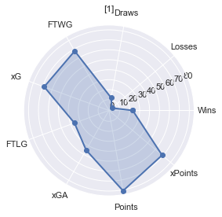
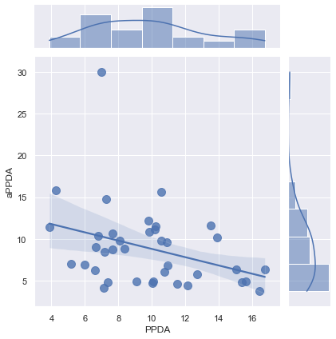
15/16
Notes:
Leicester City 2015/2016
Leicester City had positive (+ve) xG in 29 games and negative (-ve) xG in 9 games. In those 9 games with negative xG, 4 games resulted in a draw, 2 in a win and 3 in a loss. Leicester City had conceded 36 goals from a total of 45.02 xG. Leicester City conceded 379 shots from open play which led to 23 goals. Those 379 shots had a combined xG of 30.6. The xGD (Expected Goal Difference) in open play is 18.49. The opposition had 88 attempts from corners of which 7 were converted of which the opposition had an xG of 9.73. In the 38 games season, Leicester City won 23, drew 12 and lost 3 which led them to gain 81 points in the end.dependent on the xG and xGA of each and every game. To conclude Leicester City's season, the team overperformed in the category of scoring goals from inside the penalty box and did not concede goals from high xG situations which can display overperformance in their overall season.

Slide 13
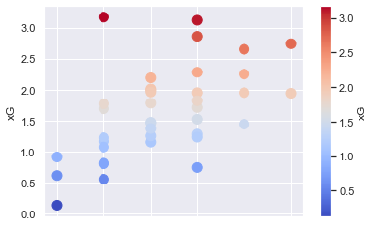
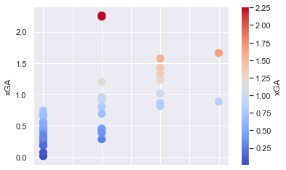
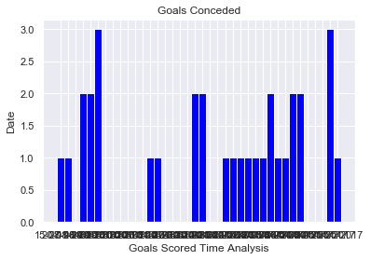
16/17
Notes:
Chelsea 2016/2017
Chelsea had just hired a new manager in Antonio Conte. The most used formation for Chelsea was 3-5-2 which was used for a total of 1919 minutes and 3-4-2-1 for 912 minutes. 3-5-2 and 3-4-2-1 are almost the same formation with the only difference coming in the midfield which includes 4 players in the 3-4-2-1 formation rather than 5 players in the 3-5-2 formation. Both these formations were used 82.7% of the total time played in the league. They scored 74 of the 85 goals in these two formations. Chelsea had attempted 421 shots in open play and scored 61 with the xG for those goals being 46.63.Chelsea overperformed massively in this department as they scored 20 goals more than probability of their shots leading to a goal.Chelsea scored 4 goals in a game where they had 1.95 xG. Chelsea scored only 1 goal where they had 3.17 xG. Chelsea overall had over performed immensely in front of goal as they had a 23.2 surge on their xG.

Slide 14
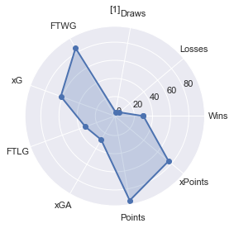
16/17
Notes:
Chelsea 2016/2017
Chelsea had conceded 33 goals from an overall xGA of 28.62. Chelsea conceded 24 goals from open play with an xG of 20.35 where they had a 26.29 xGD. They conceded only 2 goals from corners with an xGA of 3.89 having 4.87 xGD.In 38 games, Chelsea won 30 games, drew 3 and lost 5 which helped them gain 90 points in total. Chelsea went on a 13 game winning streak from 01-10-2016 to 31-12-2016. Chelsea played a 3-5-2 formation in which the emphasis was on defensive solidity with the wing backs helping in attack as well as in defense. Chelsea scored 13 goals from corners which is 15% of the total goals scored. Chelsea had positive xG in 18 games and negative xG in 20 games. Chelsea had 2.44 points per game. Chelsea like Leicester City relied on counter attack and did not stress on possession and allowed the opposition to keep possession. Chelsea’s expected points was 75.74 but they ended up on 93 points which is 17 more than they should’ve ended up with. To conclude Chelsea’s season, they overperformed in the domain of scoring goals extraordinarily and conceded limited goals which helped them secure the title.

Slide 15
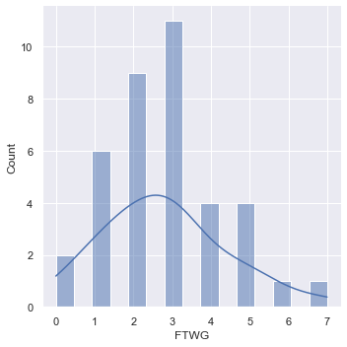
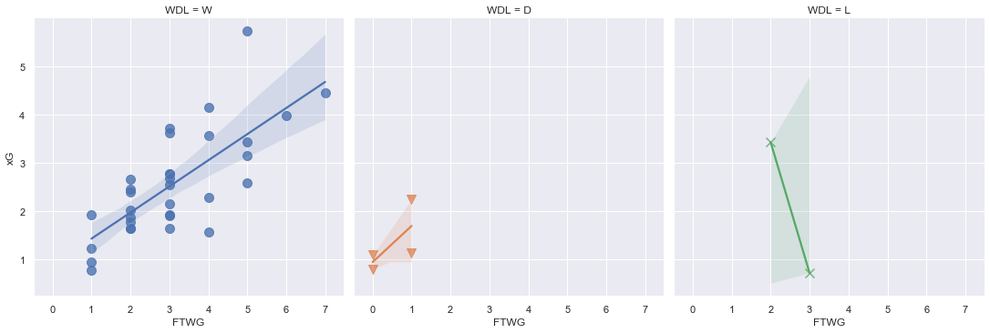
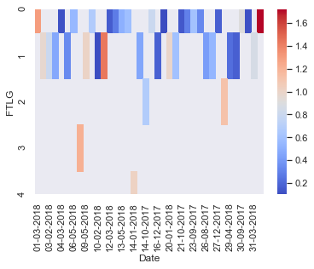
17/18
Notes:
Manchester City 2017/2018
Manchester City won the title with most points in the PL era. Their most used formation was 4-3-3 in which they used this formation for a total of 2881 minutes in the league. This formation was used for 84.2% of that total time in the league. They scored 85 of their 106 goals while using this formation. Manchester City had attempted 512 shots in open play which resulted in 85 goals. They had an xG of 76.12 from those 512 shots. Manchester City overperformed in their xG from open play. In total, Manchester City scored 106 goals from a combined xG of 91.43 which denotes that Manchester City performed a bit over their xG. Manchester City had positive (+ve) xG in 36 games and negative (-ve) xG in 2 games. In those 2 games with negative xG, 1 game resulted in a draw and the other in a loss. These games did not have any significant impact in Manchester City’s season. This displays how dominant Manchester City were in the 2017/2018 season regarding the xG statistic

Slide 16
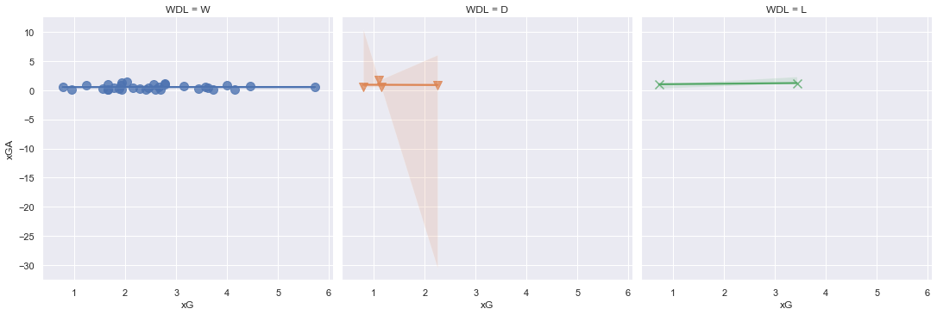
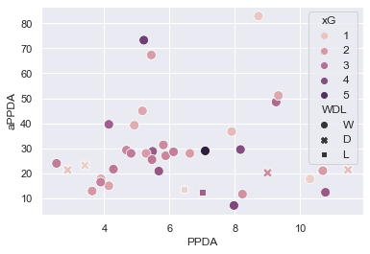
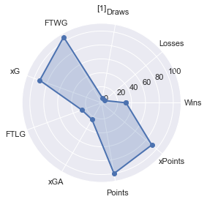
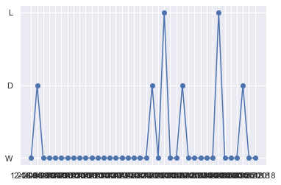
17/18
Notes:
Manchester City 2017/2018
Manchester City had conceded 27 goals from a total of 24.51 xG. Manchester City conceded 160 shots from open play which led to 23 goals. Those 160 shots had a combined xG of 18.31. The xGD in open play is 57.81. In the 38 games season, Manchester City won 32 , drew 4 and lost 2 which led them to gain 100 points which is a PL record. Manchester City went on an 18 game winning streak which came to an end after a draw with Crystal Palace. In a run of 23 games, they won 21 games, drew 1 and lost 1. Manchester City pressed constantly and always had more possession than the opponents in every game. Hence, the PPDA statistics come into play in this season as it shows how relentless Manchester City were during this season. Manchester City had negative PPDA in 37 games and positive PPDA in only 1. The expected points for Manchester City was 91.09 while they gained 100 points at the end of the season. Manchester City had 2.63 points per game. Manchester City acquired 9 more points than the expected points as this metric is dependent on the xG and xGA of each and every game. To conclude Manchester City's season, the team overperformed in the category of scoring goals from outside the penalty box and in the penalty box as well. Manchester City were defensively sound and played a high pressing game. Manchester City’s season is the epitome of the almost perfect season.

Slide 17
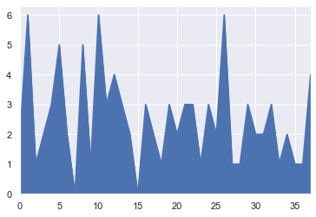
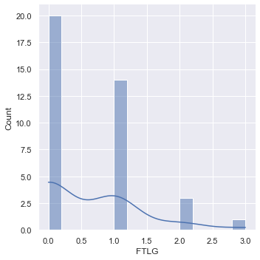
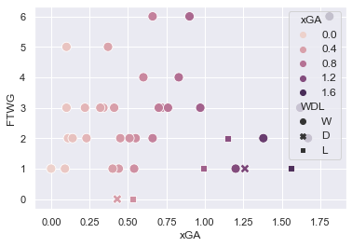
18/19
Notes:
Manchester City 2018/2019
Manchester City were the only team to retain the title in 8 years. Their most used formation was 4-3-3 again in which they used this formation for a total of 2816 minutes in the league. This formation was used for 82.3% of that total time in the league. They scored 75 of their 95 goals while using this formation. Manchester City had attempted 536 shots in open play which resulted in 80 goals. They had an xG of 82.13 from those 536 shots. Manchester City had positive xG in 35 matches and negative xG in 2 matches and null xG in 1 match. In those 3 matches with negative and null xG, Manchester City won 2 matches and lost 1 match. Manchester City overall had performed similarly to their xG which showed that the over reliance on shots leading to goals had decreased.
Manchester City had conceded 23 goals from an overall xGA of 25.73. Manchester City conceded 11 goals from open play with an xG of 17.16 where they had a 64.97 xGD. They conceded 5 goals from corners with an xGA of 3.49 having 4.14 xGD.

Slide 18
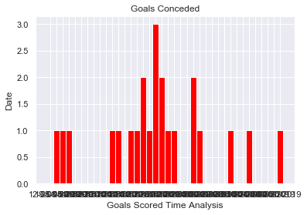
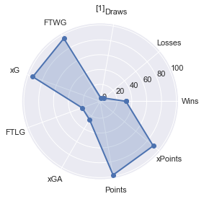
18/19
Notes:
Manchester City 2018/2019
In 38 games, Manchester City won 32 games, drew 2 and lost 4 which helped them gain 98 points in total. Manchester City went on a 14 game winning streak from at the business end of the season. Manchester City were deployed in a 4-3-3 formation which had put its focus on retaining possession higher up the pitch instantly. Manchester City scored 80 goals from open play which is 84% of the total goals scored which exhibits minimum reliance on set pieces or penalties. Manchester City had scored 56 goals in the penalty box with an xG of 60.18. Manchester City scored 20 goals from inside the six-yard box with an xG of 26.26. They scored 15 goals from outside the box with an xG of 8.6. Manchester City were efficient in the goal scoring department without overperforming as the opponents also were fairly efficient with their chances. Manchester City had 2.57 points per game. Manchester City pressed constantly and always had more possession than the opponents in every game. Manchester City’s expected points was 90.64 but they ended up on 98 points which is 8 more than they should’ve ended up with. To conclude Manchester City’s season, they performed accurately in the domain of scoring goals and conceded limited goals which helped them secure the title.

Slide 19
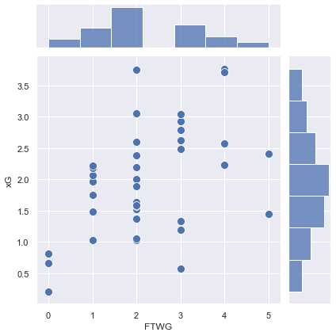
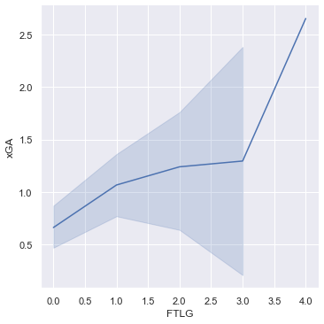
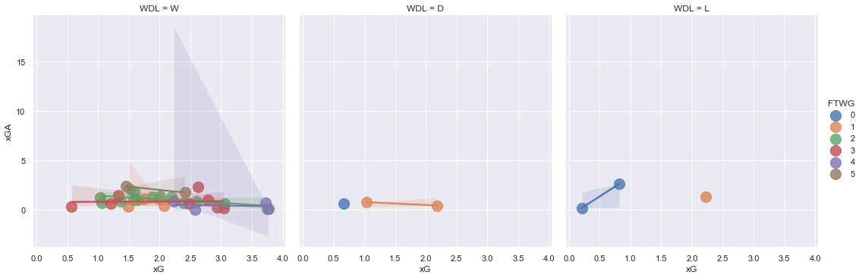
19/20
Notes:
Liverpool 2019/2020
Liverpool won the title with 2nd most points in the PL era. Their most used formation was 4-3-3 in which they used this formation for a total of 3166 minutes in the league. This formation was used for 92.57% of that total time in the league. They scored 75 of their 85 goals while using this formation. Liverpool had attempted 456 shots in open play which resulted in 63 goals. They had an xG of 62.03 from those 456 shots. In a game where Liverpool scored 5 goals, they only had an xG of 1.45. In some games, they underperformed their xG as well. For instance, Liverpool scored only 2 goals but had an xG of 3.75. Liverpool had positive (+ve) xG in 31 games and negative (-ve) xG in 6 games and null xG in 1 game. In those 6 games with negative xG, 5 games resulted in a win and the other in a loss.These games did have a significant impact in Liverpool’s season. This displays how Liverpool overperformed in the 2019/2020 season regarding the xG statistic.The overall xG was lower than the goals scored.

Slide 20
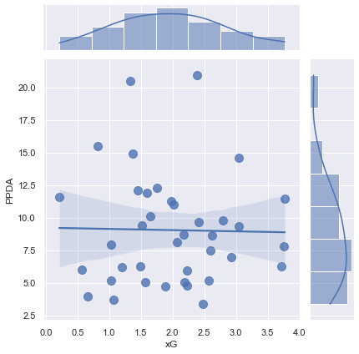
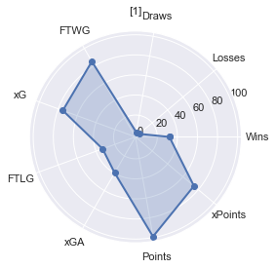
19/20
Notes:
Liverpool 2019/2020
Liverpool had conceded 33 goals from a total of 39.57 xGA. Liverpool conceded 268 shots from open play which led to 26 goals. Those 268 shots had a combined xG of 33.17. The xGD in open play is 28.86 but the difference in goals was 37. In the 38 games season, Liverpool won 32 , drew 3 and lost 3 which led them to gain 99 points. Liverpool went on a 18 game streak which came to an end after a loss against Watford. In a run of 27 games, they won 26 games and drew 1. Liverpool were deployed in a 4-3-3 formation which had put its focus on retaining possession higher up the pitch instantly. The PPDA statistics come into play in this season as it shows how relentless Liverpool were during this season regarding possession retention. Liverpool had negative PPDA in 35 games and positive PPDA in only 3. The expected points for Liverpool was 74.28 while they gained 99 points at the end of the season which is plenty greater than the probable points Liverpool were supposed to earn. Liverpool had 2.60 points per game. Liverpool acquired 24.72 more points than the expected points. Liverpool were defensively sound with the opponents not taking their chances against them. Liverpool always played a high pressing game with the full backs setting records for most goal contributions by full backs in a PL season. Liverpool’s season was drastically different to what a normal PL title winning squad would be as the overperformance in the goal scoring department is really reliant on the scorers being overly efficient which is not sustainable and cannot be replicated every season.

Slide 21
RESULT AND DISCUSSION
The title winning teams have resorted to the same playing style be it gegenpressing, counter attack or possession throughout the season.
There have been performances that are unsustainable in the long run which shows how teams fell off the next season.
Only Manchester City were able to retain the title in those 5 years.
The average goals scored over 5 seasons is 87.8 and per match is 2.304.
The average goals conceded is 30.4 and per match over 5 seasons is 0.799.
The average xG over 5 seasons per match is 2.038 and the average xGA is 0.837.
The prerequisites for winning a title not only depends on producing the numbers, playing a certain style of football, having quality players but also on teams overperforming in the department of scoring goals with regards to their xG or conceding with regards to their xGA.
The persistence on PPDA has increased since the 2017/2018 season which has given an edge to the teams on dominating possession, pressing in the opponent’s half to force mistakes so that offensive advantage can be taken.
Almost every team that has won the title has gained more points than the Expected Points which can show the overperformance in some department of the game.
All title winning teams went on consecutive winning runs which helps in steaming away from the competition.
Winning 30 games in a season seems to be the prerequisite with the number of losses wavering between 3 or 4 in a season.
Drawing games have been rare because the teams have performed exceptionally winning games that turn games into wins.
There is no demand for having high xG in every game as clinical efficiency in front of goal is an obligation in such games.
The defensive structure has to be solid as conceding more than 0.799 goals per match can eliminate possibilities of winning the title.
There is an imperative for teams to have certain players playing at the top level throughout the whole season.
This is vital in terms of scoring goals and defending the goal.

Slide 22
REFERENCES
[1] Patrice Marek and František Vávra. MathSport International 2017 Conference Proceedings
[2] Memmert D , Rein R. Dtsch Z Sportmed. 2018; 69: 65-72.
[3] Roger Penn & Damon Berridge., European Journal for Sport and Society, DOI:
10.1080/16138171.2019.1577329
[4] Javier Fernandez-Navarro, Luis Fraduab , Asier Zubillagac , Paul R. Forda and Allistair P. McRoberta. 17 March 2016, Journal of Sports Sciences
[5] Krzysztof Durlik , Paweł Bieniek. May,2014,Journal of Health Sciences.
[6] González-Ródenas, J., López-Bondia, I., Aranda-Malavés, R., Tudela, A., Sanz-Ramírez, E., & Aranda, R. (2020). Technical, tactical and spatial indicators related to goal scoring in European elite soccer. Journal of Human Sport and Exercise, 15(1), 186-201. doi:https://doi.org/10.14198/jhse.2020.151.17

Slide 23
REFERENCES
[7] Yiannakos, A., Armatas, V. International Journal of Performance Analysis in Sport · June 2006 DOI: 10.1080/24748668.2006.11868366
[8] Carlos Ruiz-Ruiz , Luis Fradua , Ángel Fernández-GarcÍa & Asier Zubillaga (2013) Analysis of entries into the penalty area as a performance indicator in soccer, European Journal of Sport Science, 13:3, 241-248, DOI: 10.1080/17461391.2011.606834
[9] Giampietro Alberti , F. Marcello Iaia , Enrico Arcelli , Luca Cavaggioni , Ermanno Rampinini.Sport Sci Health (2013) 9:151-153 DOI 10.1007/s11332-013-0154-9
[10] Alliance Kubayi. Published online 2020 Jan 31. doi: 10.2478/hukin-2019-0084
[11] P. D. Jones, N. James and S. D. Mellalieu.n International Journal of Performance Analysis in Sport · August 2004

Slide 24
PUBLICATION STATUS
Was presented in the ICCET 2021 conference held on 10th April, 2021
Paper has been applied for publication through the ICCET conference and will get accepted within a week

Slide 25
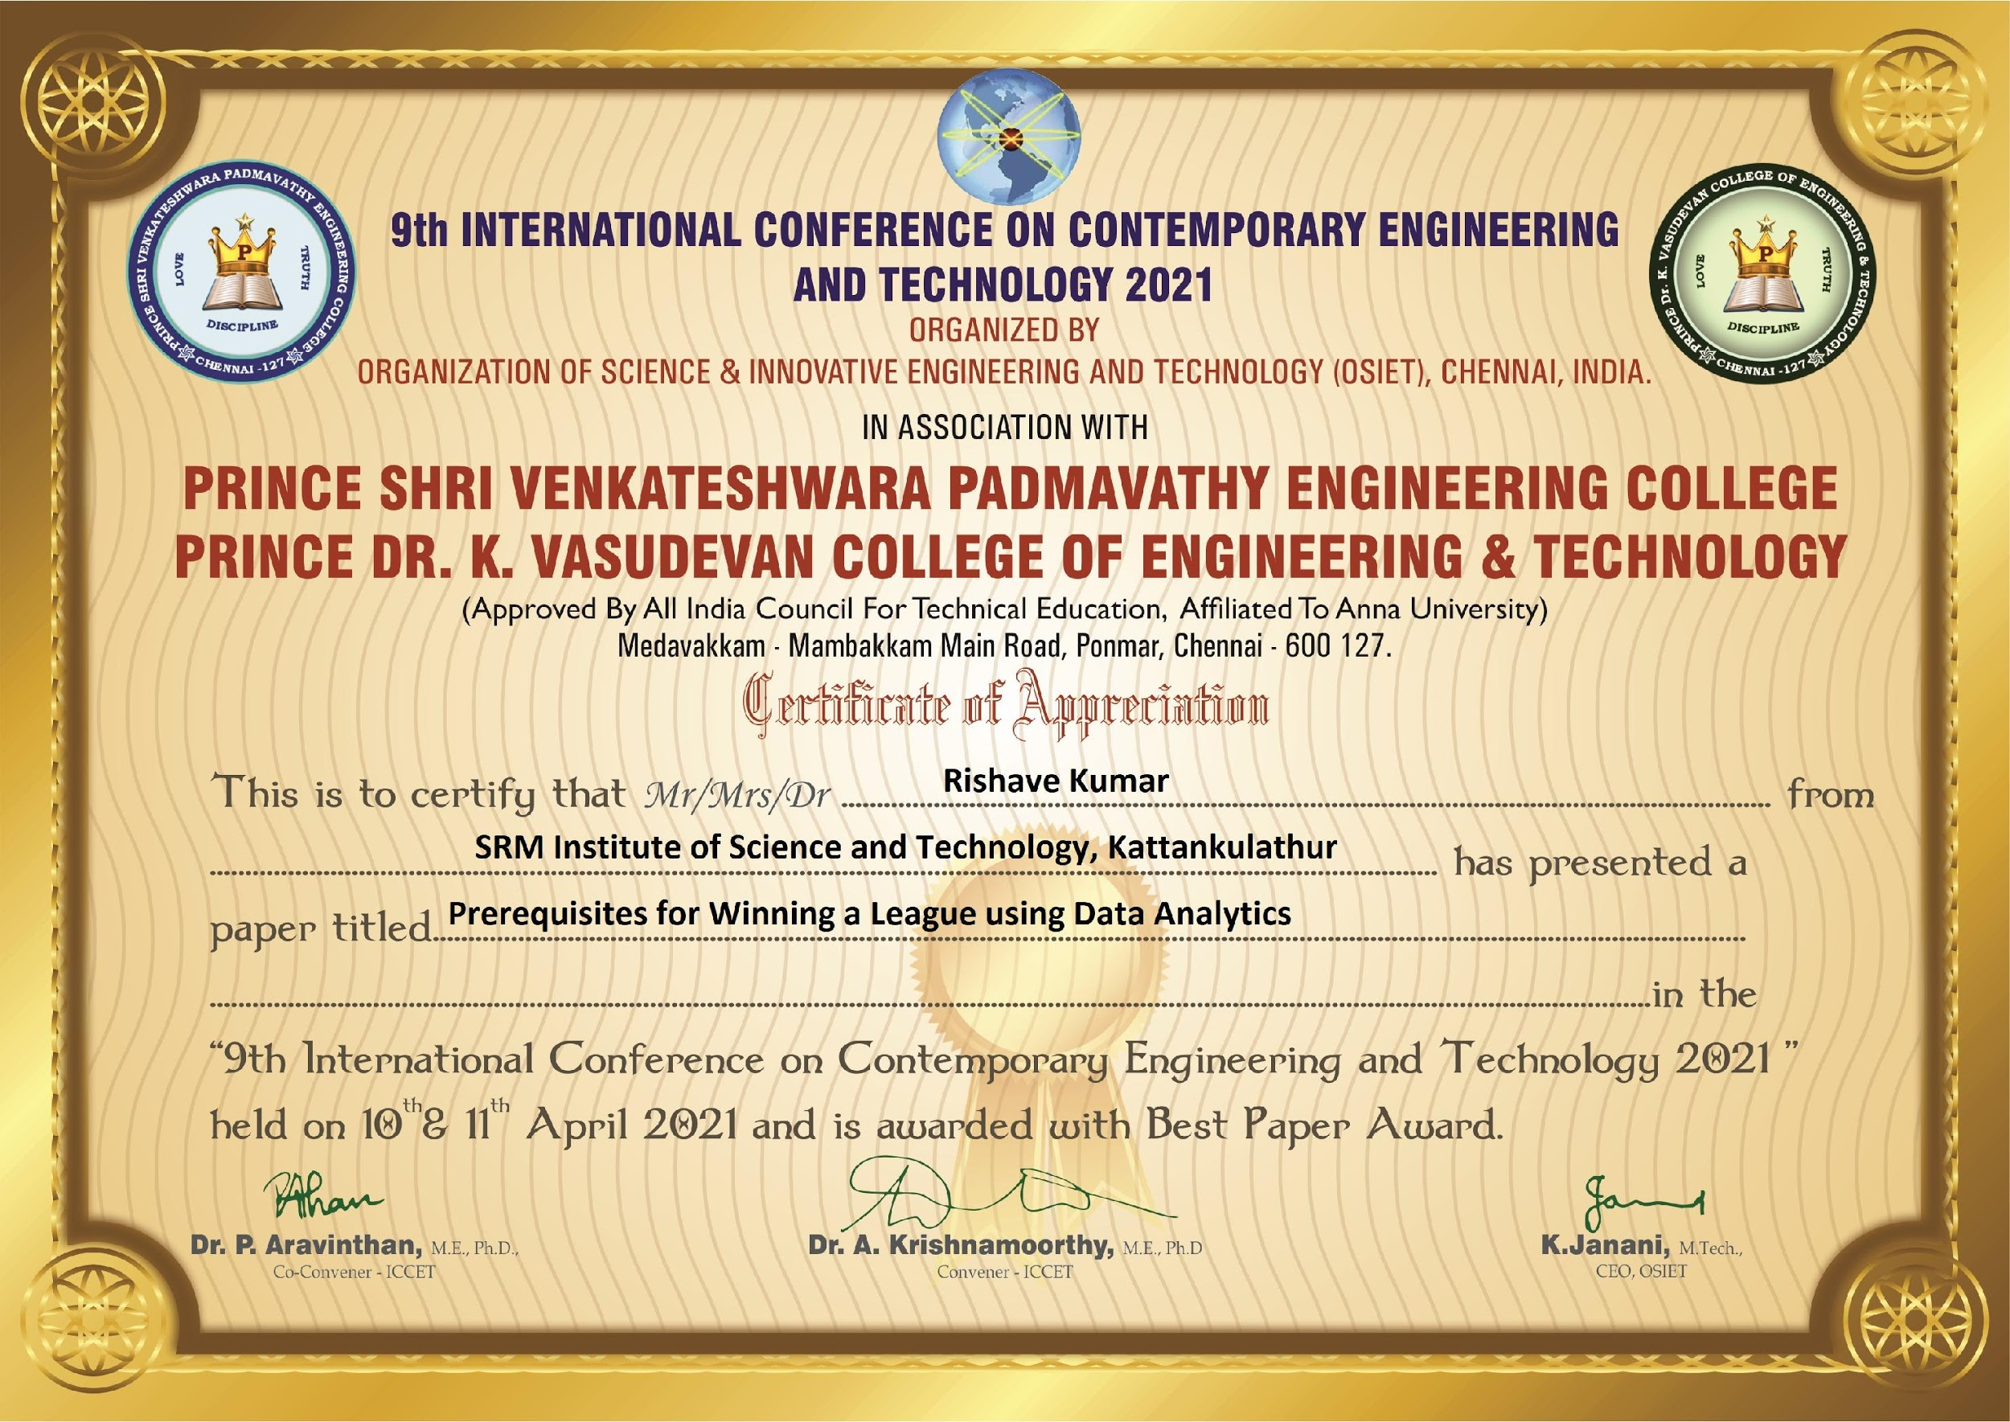
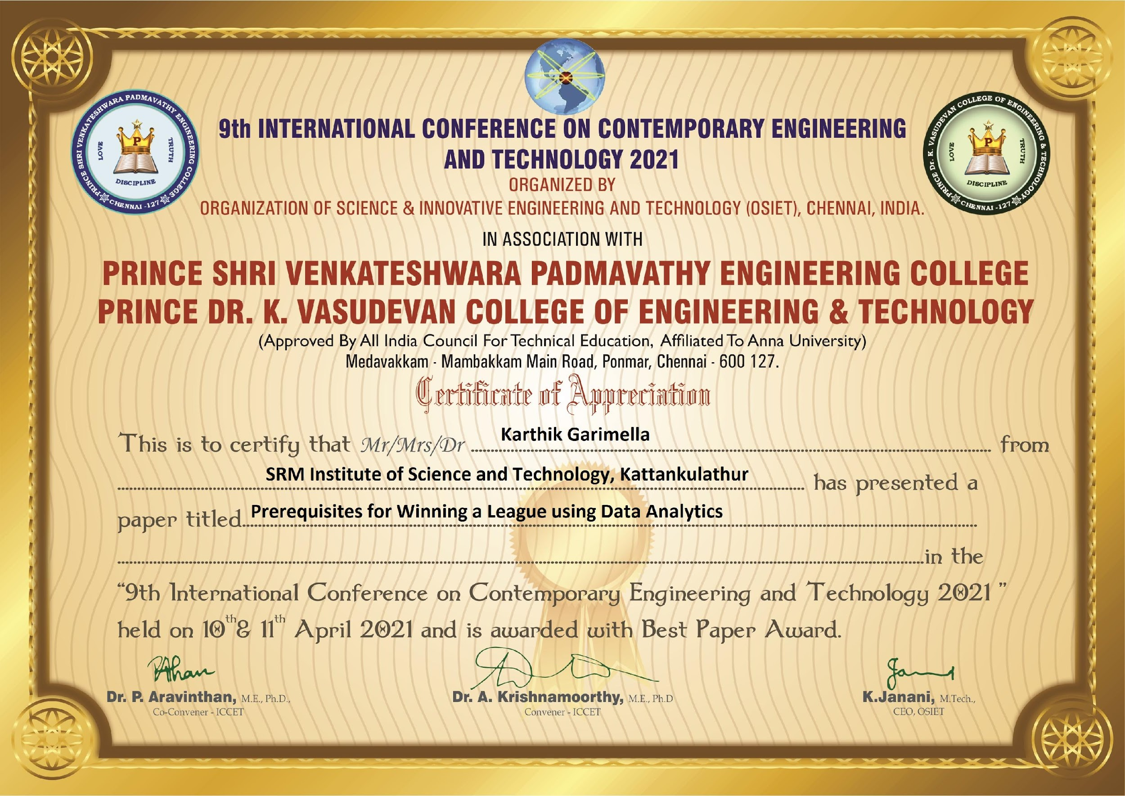
PUBLICATION STATUS

Slide 26
THANK YOU

